Slide 1
V1.2
Time Attendance System (India)
Introduction for HR
FIH OA Team
Mar 19, 2025
Notes:
大家好，接下来我开始为您介绍考勤系统。本课程适用于人资用户和IT维护人员。
Hello, I start to introduce the Time Attendance system for you.
This class is suitable for HR users and IT maintainer.

Slide 2
Agenda
Overview
Authentication & Authorization
Org. Units & Employees
Support Between Departments
Shift & Schedule
Clock Records
Absent
Leave
Overtime
Reports
Workflow
Personal Service
Notes:
首先我们会对系统做一个整体的说明，然后介绍身份认证、授权、组织、员工，在然后是系统的核心数据，包括排班、刷卡记录、缺勤、请假、加班等内容，最后是报表、电子签核和个人服务功能。
First, we will give an overview of the system, then introduce identity authentication, authorization, organization, employees, and then the core data of the system, including scheduling, card swiping records, absences, leave, overtime, etc., and finally reports, electronic signatures and personal service functions.

Slide 3
Overview
System Advantages
System architecture
Data processes
…
Notes:
整体说明主要包括系统优势、功能结构和数据处理的一般过程。
The overview mainly includes system advantages, functional structure and general process of data processing.

Slide 4

System Advantages
Architecture
Functional
Same framework as China and Vietnam sites.
Web application, no need to install.
Multi-language support English & Chinese.
Provide e-approval with PC/Internet/Mobile.
Batch import all data by Excel.
Judge clocking in or out automatically.
Support employee moving between departments.
Security control and traceability for different users.
Integration
Efficiency
Integrated with Biometric Device
Integrated with Personnel Management System
Integrated with Organization Management System
Integrated with FIH Workflow Engine and Portal
Integrated with Mobile App for self service
Integrated with Single-sign-on
Judge absent by raw data automatically.
Calculate overtime and work time automatically.
Arrange employee’s schedule by shift pattern.
Split work into different roles and share workload.
Notes:
这个系统基于中国和越南厂区相同的框架设计，并依据印度法律法规做了定制化。
首先，它是一个网站应用，无需安装，并同时支持英文和中文。它提供了跨平台的电子审批功能。
其次，系统与多个相关系统进行了整合，包括生物识别设备、人事管理系统，组织管理系统，FIH工作流引擎和入口，单点登录等。
在功能方面，系统主要采用EXCEL批量导入方式添加数据，这可以方便大数据量操作。系统自动判断打卡记录时上班还是下班。系统支持员工在部门间临时移动。系统提供安全管控和用户操作的跟踪。
为了提升效率，系统自动根据原始数据判定缺勤，自动计算加班和工时，自动根据班次模式对员工进行排班。系统也将工作按照角色进行分解，分摊工作负荷。
The system is based on the same framework design as the China and Vietnam sites, and is customized according to Indian laws and regulations.
It is a website application that does not require installation and supports both English and Chinese.
It provides cross-platform e-approval functions. Second, the system is integrated with multiple related systems,
including biometric devices, personnel management systems, organizational management systems, FIH workflow engines and portal, single sign-on, etc.
In functions, the system mainly uses EXCEL batch import to add data, which can facilitate large-scale data operations.
The system automatically determines clock record is punching in or out.
The system supports temporary movement of employees between departments.
The system provides security control and tracking of user operations.
In order to improve efficiency, the system automatically determines absence based on raw data,
automatically calculates overtime and working hours,
and automatically schedules employees according to shift patterns.
The system also decomposes work according to roles to share workload.

Slide 5
Data Analysis Process
External Application
Master Data
Raw Data (Excel Import / e-Approval)
Personnel Administration
Departments
& Employees
Shift Schedule
Overtime
Leave
Clock Records
Biometric Device
Clock records
Daily Analysis
Shift Definitions & Patterns
Daily analysis result
Overtime Type & Category
Daily Work Time
Daily Overtime
Daily Absent
Overtime Upper limit
Leave Balance
Monthly Analysis
Monthly closing date
Payroll Management
Paydays Report
Monthly analysis result
Mobile App
Paid / Unpaid Days
Monthly OT
Monthly Balance
Employee Self Service Report
Notes:
我们首先需要在系统维护Master Data，包括班次定义，加班类别，以及从其他系统同步的人事资料和打卡数据。
接着作业人员会用EXCEL导入 Raw Data, 其中有些数据是需要经过电子审批才生效的。比如排班、加班、请假、补卡等。
每天系统会自动进行数据分析，分为两个层次：日分析和月分析。日分析将每天的数据按天计算得到当天的工时、当日有效加班、当日缺勤。
月分析则是在日分析结果的基础上，按照加班管控和休假上限，进一步计算得到当月的支付与不支付天数，月度有效加班等。

Slide 6
Functional Architecture
Reports
Personal Service
Basic Data
Daily Reports
Abnormal Record
Shift - Arrangement
Analysis
Monthly Reports
Shift - Daily Schedule
Monthly Overtime
Daily Analysis
Period Reports
Shift – Date Type Exchange
Period Overtime
Monthly Analysis
Payment Report
Attendance - Clock Records
Clock Records
Attendance - Leave
Calendar View
Attendance - Special
Time Attendance System
Overtime – Personal Category
Overtime – Data Maintain
Parameters
Overtime - Special
Shift Definition
Overtime - Remaining
Workflow
Historical Data
Administration
Shift Pattern
Support Out(Original)
Overtime Application
Overtime
User Management
Public Holiday
Support In(Destination)
Shift Schedule Application
Shift Schedule
Role Management
Leave Type
Leave Application
Leave
UI Localization
Overtime Class
Clock Record Application
Clock Record
Data Localization
Overtime Limitation
Customized Supervisors
…
Announcements
Close Time Setting

Slide 7


Server Deploy Architecture
Intranet
China
https://hr.efihmb.com
India
https://inta.efihmb.com
Vietnam
https://fsta.efihmb.com
Website
Website
Website
Database
Database
Database
API
API
API
Internet
LH Server
Unified e-Approval (PC)
https://taworkfow.fihtdc.com
Mobile Self Service
(Query and Apply)

Slide 8
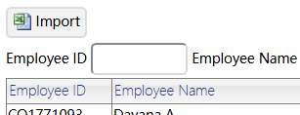
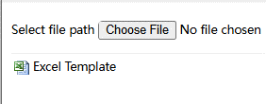
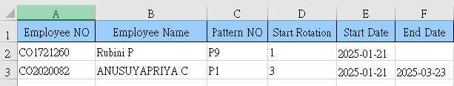
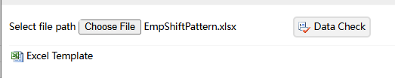
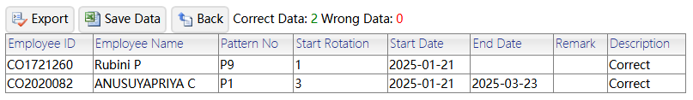
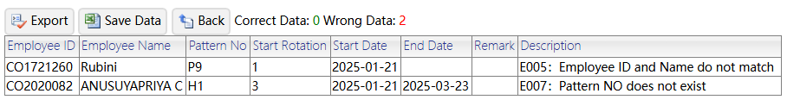
Batch Excel Data Import Process
All Excel data imports use the same method, which will not be discussed in detail later.
1
Click the “import” button
2
Click “Excel Template” to download
3
Fill in the data as shown in the example
4
Choose file, and click the “Data Check”.
5
If results are “Correct”, then click “Save Data” to complete.
6
If not correct, then modify Excel file, and redo 4 and 5 steps .

Slide 9
Authentication & Authorization
Login system with SSO
Authorize for different roles
Examples for different type of users

Slide 10
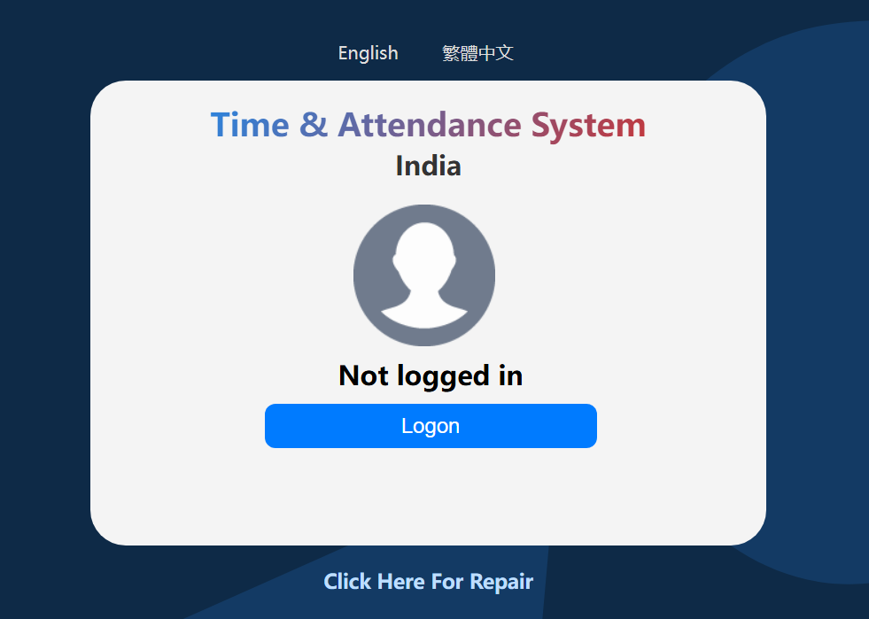
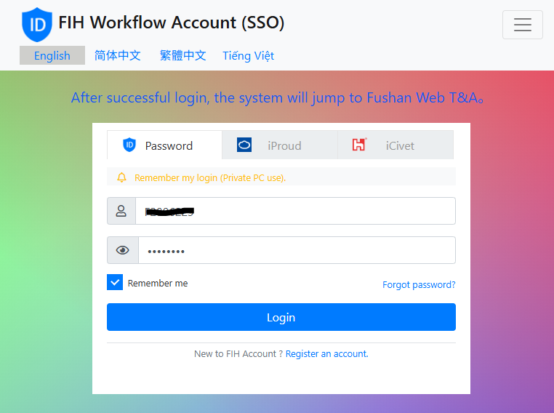
Authentication(Login)
Time Attendance System (India):
Production:
https://inta.efihmb.com
(only for intranet)
Testing:
https://inta-testing.efihmb.com
FIH Workflow Account create account for all employees
* E-approval and self service can access from internet.

Slide 11
Authorization 1 - Dimensions
Roles
Permissions
Default Roles
Predefined collection for permissions
High
HR Administrator
Permissions
HR Administrator for sites.
User
Web pages and functions directly.
not recommended
BU/SBU HR Window
Org. Units
Department Window
Control data permission by departments
Approvers
Sites
Common Users
Control data permission for different sites.
Low

Slide 12
Authorization 2 – Examples
Some examples:
User | Role | Org Unit | Site | Remark
User A | HR Super Administrator | All org. units | All sites | HR head or general window, who has all permissions.
User Test01 | HR Administrator for Sites | All org. units | TN | TN HR general window, who has all TN permissions.
User Test02 | HR Administrator for Sites | All org. units | Site1 | HR window in change of Site1, who has all Site1 permissions.
User Test03 | BU & SBU Window | All DMS departments | All sites | HR window of DMS, who has all DMS permissions, but can not do something like administrator.
User Test04 | Department Window | Some departments | All sites | HR window of some departments, who has departments permissions, but can do something permitted.
User Test05 | Common User | None | None | Can only use personal service, and workflow application.

Slide 13
Organization Units & Employees
Organization structure
Employees’ fields

Slide 14
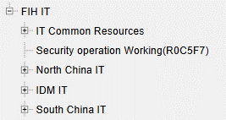

Organization Structure
Organizations sync directly from PA (Personnel), and indirectly from organizational management system.
Organization Properties:
Org. Unit ID:
RB9T77
Unique ID for an organization unit.
Org. Unit Full Name:
FIH-FIH BG-DMS-FIH IT Division-INDIA IT Dept.
Sometimes it need to map with ID while data import.
Abbreviation Name:
INDIA IT Dept.
Cost Center:
RB985GT7
Cost center or expense code in SAP
Organization Level:
Department
Should be one of BU, SBU, Division, Department, Section
It will be used for authorized final approval.
Supervisors:
502599 Michael Chao
Should be one or two managers.
It will decide the approver for e-approval flow.
Parent Organization:
R0C007 - FIH IT
If one user have permission for an organization unit,
then also have permission for all sub organization units.

Slide 15
Employee Fields
Employees sync from PMS (Personnel Management) , twice(can be changed) everyday automatically.
Properties | Example1 | Example2 | Description
Emp. ID | RS000XXX | C0315XXX | Unique ID for every employee or outsourcing people.
Emp. Name | Tamilar XXX | LAVAN XXX | Must be mapped with emp. ID exactly while import data from Excel.
OrgUnit ID | R3U4XX | R3S3BX | Unique ID for any level organization unit, including section level or division level.
Job Grade | Engineer 5 | Outsourcer | Decide the e-approval final level of overtime & leave application.
Position | Manager | Operator | Decide the e-approval final level of overtime & leave application.
Date of Join | 2020-10-02 | 2023-04-15 | Used to calculate Annual Leave days.
Status | Active | Inactive | Used to determine whether employees are on the job or leaving the company.
Date of Resign | / | 2024-12-09 | Used to calculate pay days.
Gender | Male | Female | Used to do data check for some leave, like Maternity Leave, Pregnancy Check Leave.
DL/IDL | IDL | DL | Used to control upper limit for overtime
Company | RL | CL | Used to separate permissions for outsourcing

Slide 16
Support Between Departments
How support impact permissions
Support Out
Support In

Slide 17


How support impact permissions
Human support is a temporary short-term move, which is different from permanent changes in personnel information.
Clock records impact
Support Out（Original）
During the employee support period, the original unit does not have any permissions
Go to the destination department to punch in and out of get off work.
E-Approval impact
The relevant sign-off process will capture reviewers according to the destination department.
Leave impact
1
Clock records impact
Leave application is based on the target department.
Support In（Destination）
2
Sign-off impact
3
Leave impact
Work overtime impact
4
Work overtime impact
The target department has the authority to apply for overtime.

Slide 18
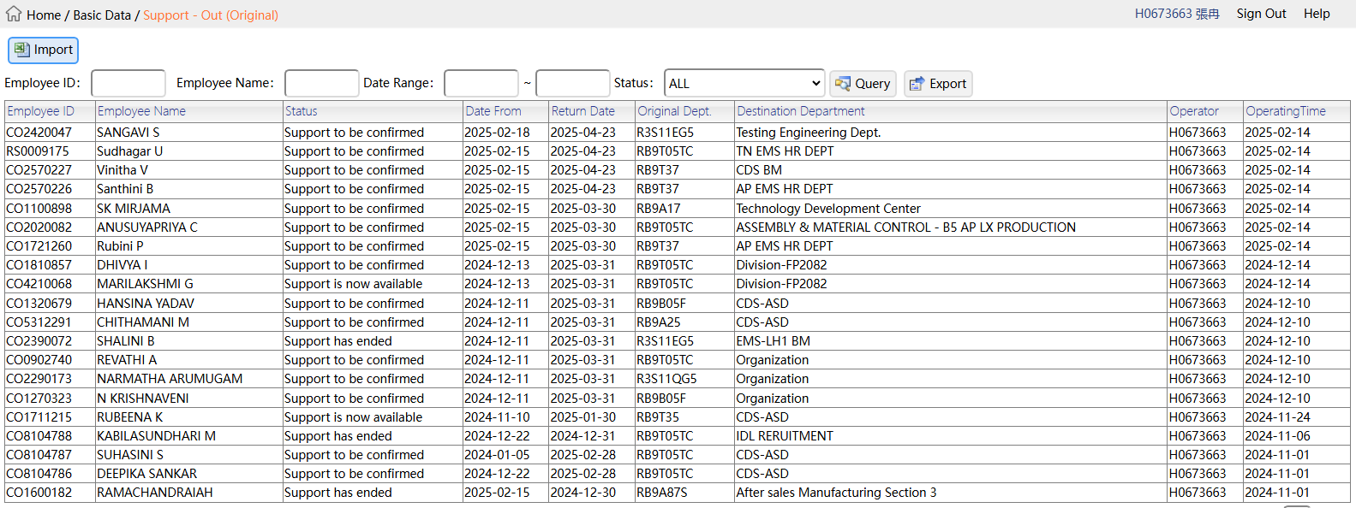
Support Out - 1
Support Out department related information.
1. The status is：Support to be confirmed、Support is now available、Support has ended、Support canceled.
2. The user does have department or site permissions.

Slide 19
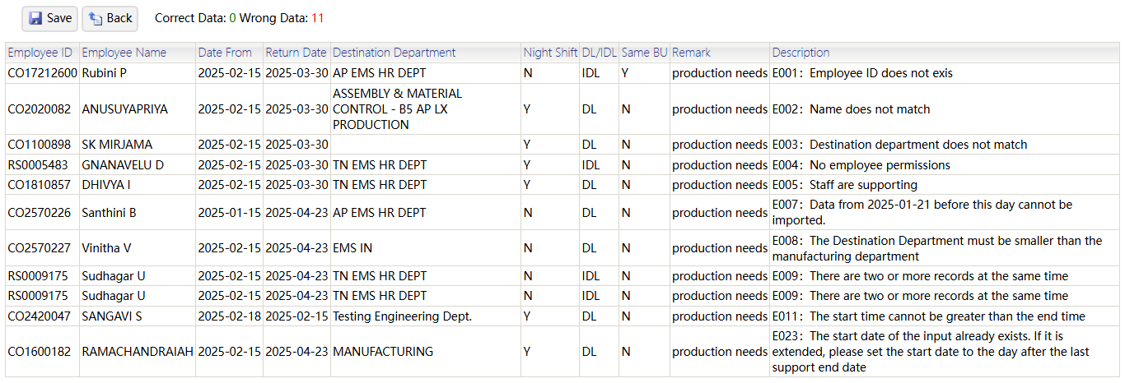
Support Out - 2
An example of check results:
Detailed explanation of check rules:
E004: User does not have department or site permissions.
E007: Only support data for the current month can be imported.
E023: If the extension is extended, please set the start date to the day after the last support end date.

Slide 20
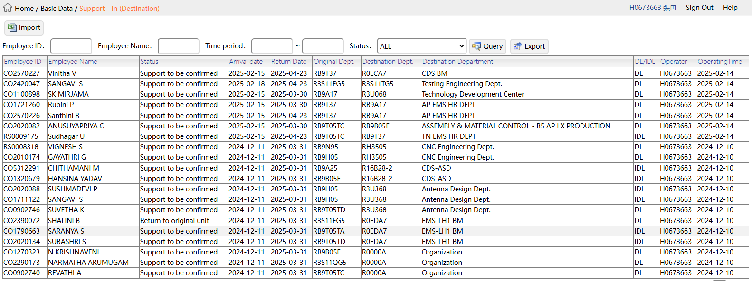
Support In - 1
Support In department related information.
1. The status is：Support to be confirmed、Effectove support 、Support canceled 、Return to orginal unit.
2. The user does have department or site permissions.

Slide 21
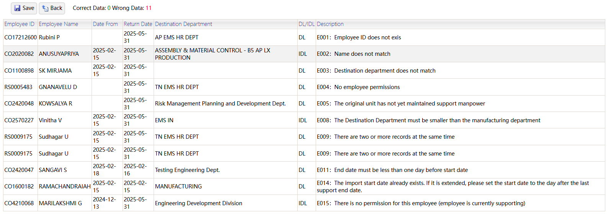
Support In - 2
An example of check results:
Detailed explanation of check rules:
E004: User does not have department or site permissions.
E011: If you want to cancel support, the end date only needs to be one day before the start date.
E015: If the extension is extended, please set the start date to the day after the last support end date.

Slide 22
Shift & Schedule
Shift and schedule overview
Shift and shift pattern definition
Shift Arrangement
Employee daily schedule
Date type exchange

Slide 23
Shift and Schedule overview
Pattern | Rotation |  |  | Weeks Rotation1 | Days per Week (Rotation1) | Weekend (Rotation1) | Weeks Rotation2 | Days per Week (Rotation3) | Weekend (Rotation2) | Weeks Rotation3 | Days per Week (Rotation3) | Weekend (Rotation3)
 | 1 | 2 | 3
P1 – 6W1R | C | B | A | 1 | 7 | 1 | 1 | 7 | 1 | 1 | 7 | 1
P4 – 6W1R | A | B |  | 1 | 7 | 1 | 1 | 7 | 1
P7- 6W1R | A |  |  | 1 | 7 | 1
P9- 5W2R | G |  |  | 1 | 7 | 2
P15- 6W1R 5W2R | A | G |  | 1 | 7 | 1 | 1 | 7 | 2
Shift Definition
(A B C D )
Shift Pattern Definition
(Special Examples Rotation)
P1 P4 P7 P9 P15
Shift Arrangement
Employee ID | Pattern | Start Date | End Date
C1XXXXX | P1 | 2024/12/6
C1XXXXX | P2 | 2024/12/6 | 2024/12/6
1. Arrange schedule by shift pattern，overwrite if exist.
2. Generate schedules six months while no end date.
3. Reduce previous continuous duty days automatically.
Employee ID | Date | Shift | Date Type
C1XXXXX | 2024/12/6 | A | G1
C1XXXXX | 2024/12/7 | G | G2
C1XXXXX | 2024/12/8 | G | G2
Daily Schedule
The core base for employee’s calendar,
attendance, absent, leave, overtime and others.
Background Job
Date Type Exchange
1. Generate schedules by job automatically
2. Six months shift schedule for pattern no end date.
3. Only add data, not overwrite.
1. Update schedules while data import.
2. Need to check shift date and Date type.

Slide 24
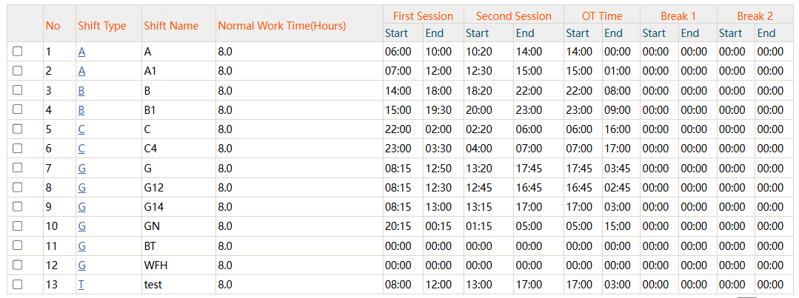
Shift Definition

Slide 25
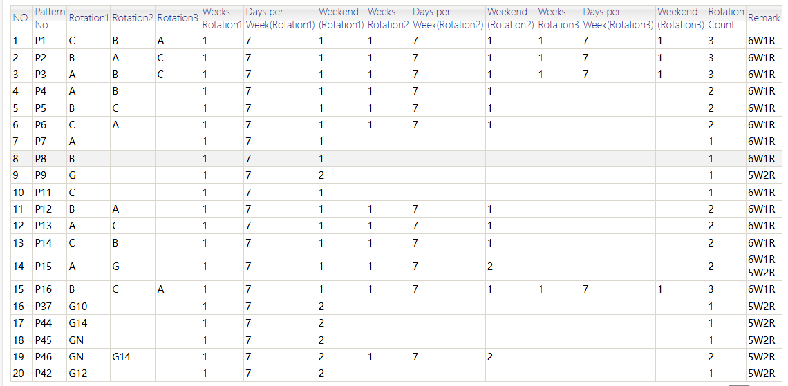
Shift Pattern Definition

Slide 26
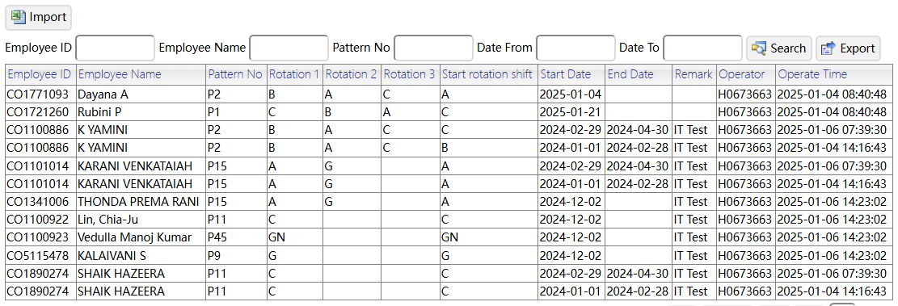
Shift Arrangement
Arrange employee’s shift schedules by shift pattern.
1. Schedule according to a date range. If end date is empty, system generate six months automatically, and will extend everyday.
2. System automatically splits into daily schedules. If someone were already at work the day before, it will be automatically deducted.

Slide 27
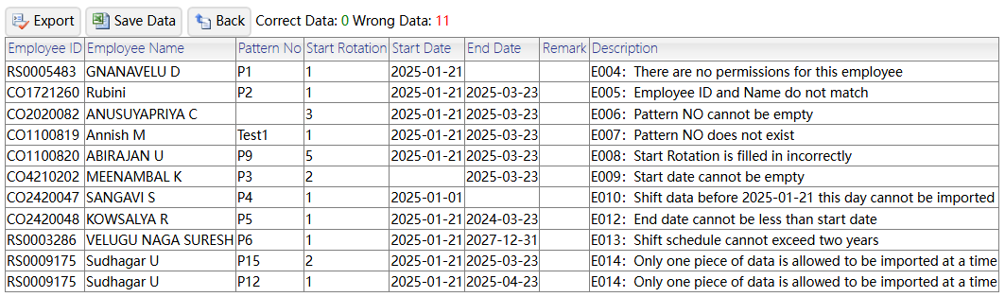
Shift Arrangement - 2
An example of check results:
Detailed explanation of check rules:

Slide 28
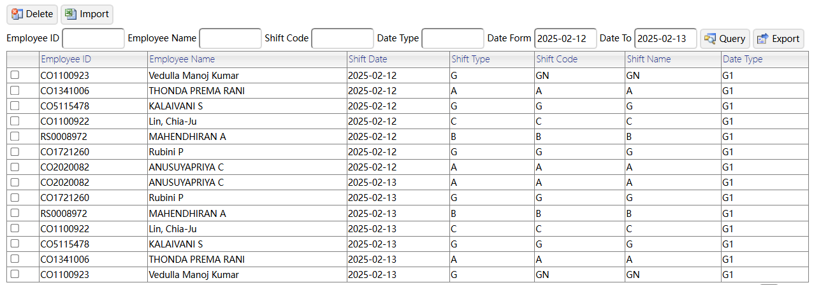
Employee Daily Schedule - 1
Daily arrange employee’s schedule, including shift and OT type.
G1: normal work day, G2: Weekend, G3: public holiday.
Each employee must have a corresponding OT Type every day, and all employees need to be scheduled every day,
otherwise it will affect operations such as overtime and leave requests.

Slide 29
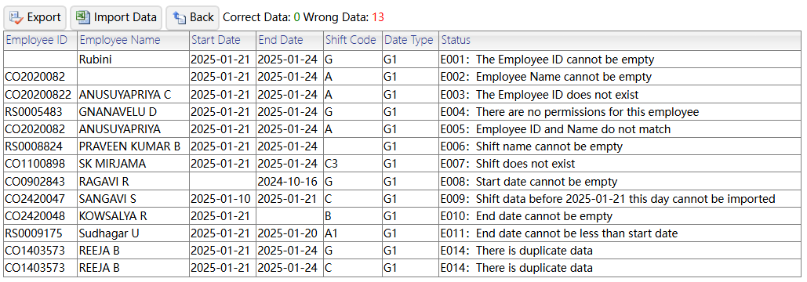
Employee Daily Schedule - 2
An example of check results:
Detailed explanation of check rules:

Slide 30
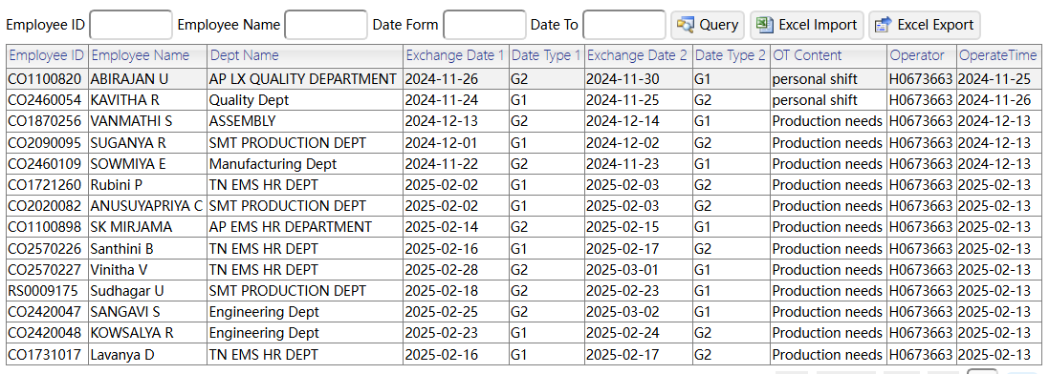
Date Type Exchange - 1
This function is used to exchange working days and rest days for certain employees.
For example: 2024-11-26 is G1(working day), 2024-11-30 is G2(Weekend).
Then can import data to exchange 2024-11-26 to G2(Weekend), and 2024-11-30 to G1(working day).

Slide 31
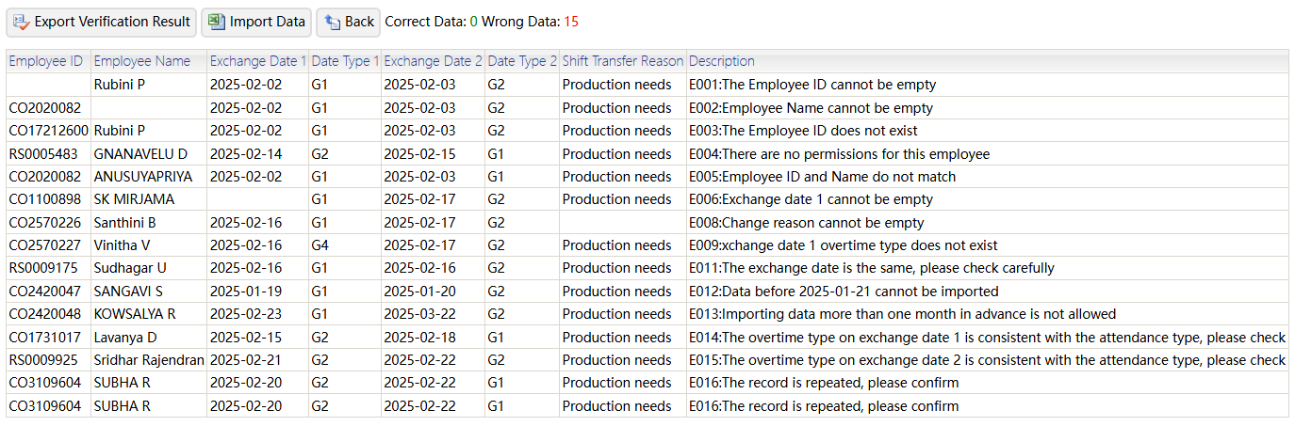
Date type exchange - 2
An example of check results:
Detailed explanation of check rules:
E004: User does not have department or site permissions.
E009: Date types are G1, G2, and G3.
E014: The date type of exchange date 1 and the date type of exchange date 2 must be inconsistent with the scheduling type.

Slide 32
Clock Records
Clock records data source
Clock records rules
Clock records import manually
Clock in/out workflow approval

Slide 33
Clock Records Data Source
1.Data of Clock in/out comes from Fingerprint machine and new Face recognition machine (future).
2.Each Machine is used for both clock in and clock out , system will identify automatically.
3.System sync data every 3~10 minutes.
Time Attendance
Database
Biometric Devices
Biometric Database
Sync
per 3~10 minutes
10010
……
10015

Slide 34
Clock Records Rules
There are there ways to import Clock records
1.Employee apply Clock records by themselves with Workflow Approval.
Workflow >> Clock Record Application>>Personal Application
2.Department Window help to apply Clock records with Workflow Approval.
Workflow >> Clock Record Application>>Batch Import
3.HR Window help to add Clock records directly without Workflow Approval
Basic Data>>Attendance – Clock Records

Slide 35
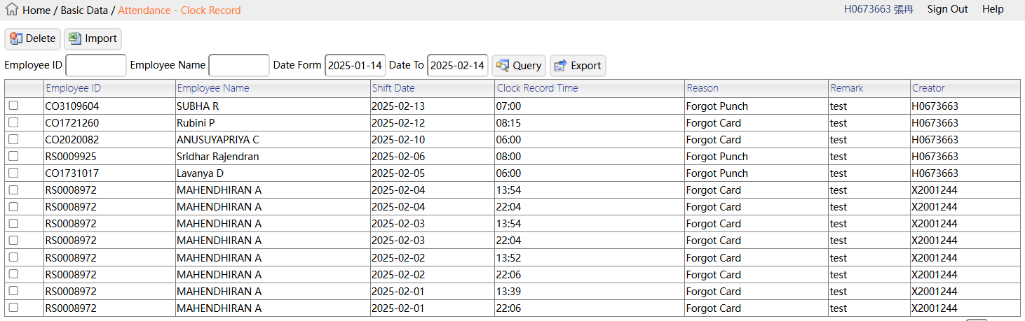
Clock record import manually
HR /Department Administrator can import Clock record for Employee who can not apply by themselves
1.Department Administrator import need workflow approval
2.HR Administrator import no need workflow approval
3.If the record is the out record of night shift ,it will show (+24H)

Slide 36
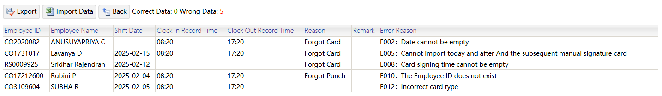
Clock record import manually
An example of check results:
Detailed explanation of check rules:
E001: The Employee ID cannot be empty
E002: Date cannot be empty
E003: Manual signature card type error
E004: The Clock Record has not been completed on this day, please do not apply again
E005: Cannot import today and after And the subsequent manual signature card
E006: Clock in crosses the day error
E007: Clock out crosses the day error
E008: Card signing time cannot be empty
E009: Individuals are not allowed to enter forgotten card swipes throughout the day. Please contact the attendance window for operation.

Slide 37
Clock record import manually
Detailed explanation of check rules:
E010:The Employee ID does not exist
E011:There is no record of Clock Record application.
E012:Incorrect card type
E013:Employee ID and Name do not match
E014:No authority or the card signing date is not within the employee support period
E015:During the employee support period, the original unit is not allowed to import
E016:Shift data before this day cannot be imported
E017:This Clock Record conflicts with the leave application that has not yet been approved. Please do not perform both operations at the same time.
E018:The employee did not work overtime on that day
E019:Clock Record is not allowed during holidays
E020:The employee did not absence work that day
E021:There is a problem with the scheduling data
E022:Clock out time is longer than the shift schedule
E023:The record is repeated, please confirm

Slide 38
Absent
Type of Abnormal Attendance
Logic of absence
Special Treatment

Slide 39
Type Of Abnormal Attendance
Late To Work
Off Work Early
Leave
Casual Leave
Sick Leave
Earned Leave
……
Compensation Off
Abnormal
Attendance
Absent
Absence Type | Logic
Absent Full Day | 1.No leave request. 2.No clock record all day
Absent First Half Shift | 1.No Leave request 2.Only clock out record
Absent Second Half Shift | 1.No Leave request 2.Only clock in record
No Date Type | Haven’t modified date type for employee that day
No Shift Arrangement | Haven’t arranged shift for employee that day

Slide 40
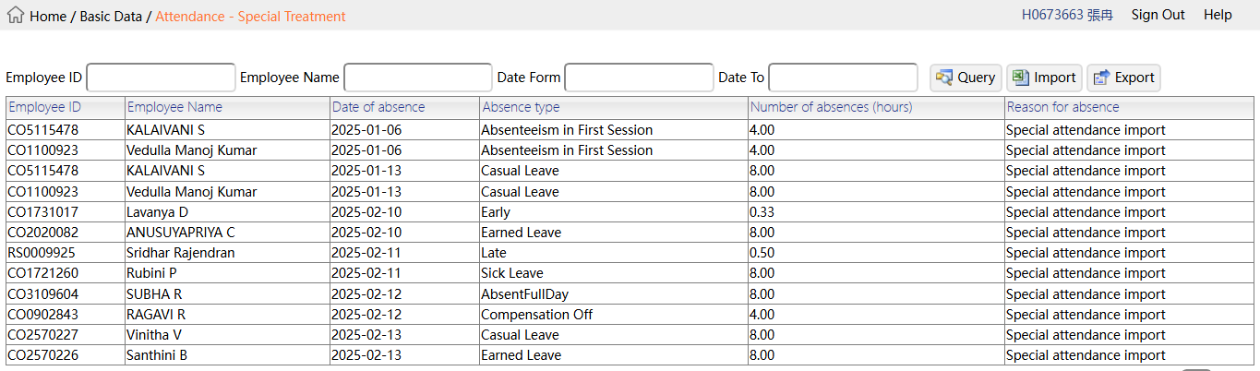
Attendance - Special Treatment
Special Treatment related information.
1. Special attendance types are divided into: lateness, early departure, leave, absence from work, and public holidays.
2. Special attendance can meet multiple leave requests in one day.
3. Special attendance is used to force correction of the results of data analysis.
① One is that the employee has a normal clock-in record, but did not come to work, and needs to be forcibly corrected
as absenteeism
② The employee took paid leave and was forced to change it to unpaid personal leave.

Slide 41
Leave
Leave Type
Leave Data Import
Approval process for leave application
Paid Leave Rules
Annual Leave Rules

Slide 42
Leave Type
Leave Type | Rules
Casual Leave | At least 0.5 days off per month and at most 3 days off per month
Sick Leave | A maximum of 12 days off per year
Earned Leave | EL Leave Balance present days / 20
Earned Leave Advance | Maximum of 30 days off
Marriage Leave | Apply only 3 consecutive working days. OFF or holiday doesn't count.
Bereavement Leave | Apply only 3 consecutive working days. OFF or holiday doesn't count.
UnPaid Leave | A maximum of 6 days of leave per year
Non ESI Maternity Leave | 120 days
ESI Maternity Leave | 120 days
For details on other leave types, please consult HR

Slide 43
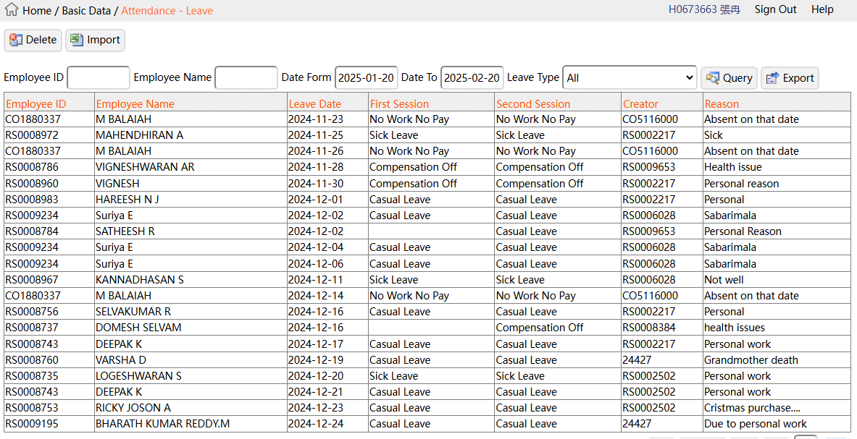
Leave Data Import - 1
Arrange employee’s leave data.

Slide 44
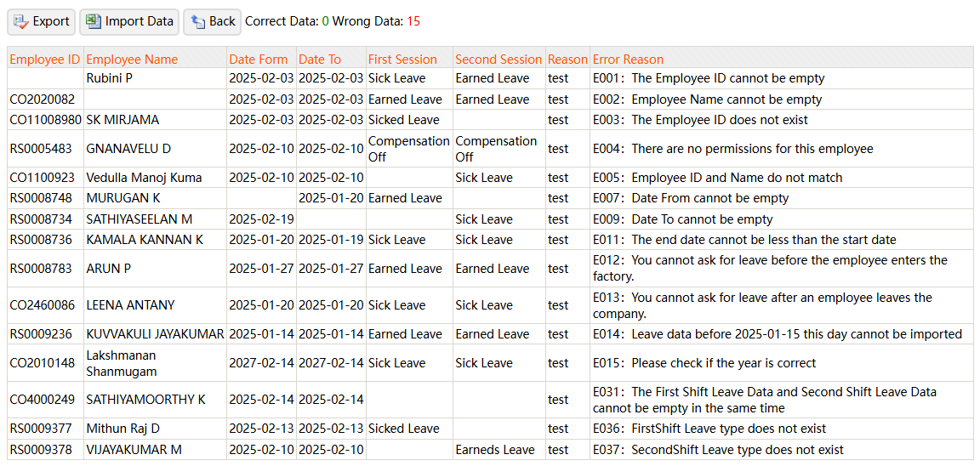
Leave Data Import - 2
An example of check results:

Slide 45
Leave Data Import - 3
Detailed explanation of check rules:
E004: User does not have department or site permissions.
E014: Operators can only import leave request data within the permissions allowed. Importing data that exceeds the time limit is not allowed.
E044: Annual Leave/Child Sick Leave(SI)/Military Service Leave/Sick Leave Paid By Company/Total Stoppage leave/Travel Leave/Unauthorized absence Leave only can apply for First Shift/Second Shift/Full Shift
E058： These leaves must be taken consecutively ：Mariage Leave、Bereavement Leave、Non ESI Maternity Leave、ESI Maternity Leave ESI
E062: Maximum of 3 days of paid leave per month
E068：Marriage leave cannot more than 3 days
E074： Bereavement Leave cannot more than 3 danys
E075： Non-ESI maternity leave 182 days
E076： ESI maternity leave 182 days
Others based on company rules and regulations

Slide 46
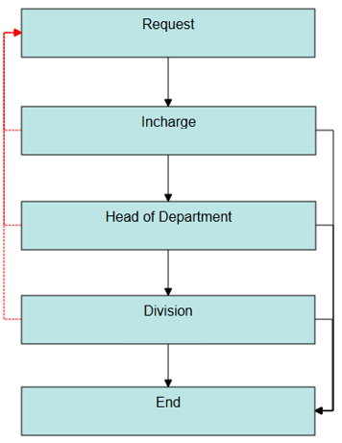
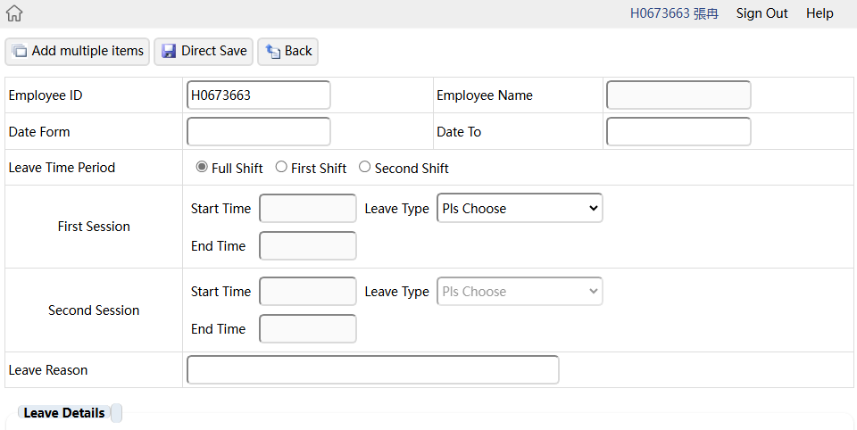
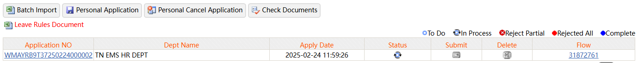
Leave Approval Process
If you apply for multiple types of leave on the same day, you need to import multiple entries at once, otherwise they will be overwritten.
Click here to import leave data
After successfully importing and saving the data, click the Submit button to submit the leave application form for review.

Slide 47
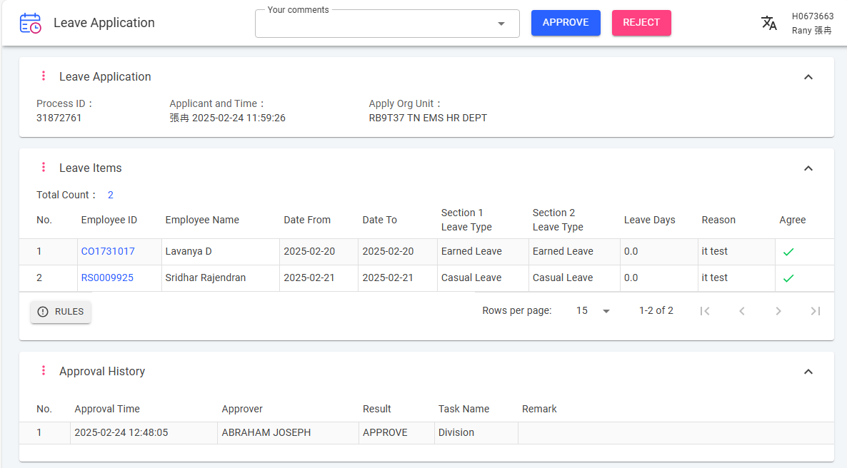
Leave Approval (UI)
Supervisors login workflow account for approval
Comments
Leave Application
Leave Items
Approval History

Slide 48
Overtime
Date Type & Overtime Class
Overtime Limitation Control
Overtime Data Import & Check Rules
Overtime Application & Approval Process
Special Overtime

Slide 49
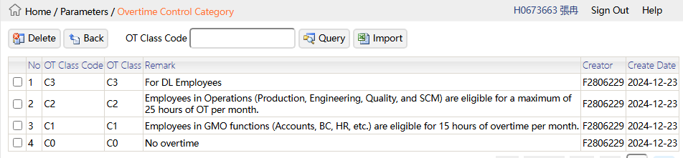
Date Type & OT Class
Date Type
G1
G2
G3
Working days
Weekends
Holidays
Overtime Class
For OT upper limit control
HR can define different classes of overtime in order to control overtime hours.

Slide 50
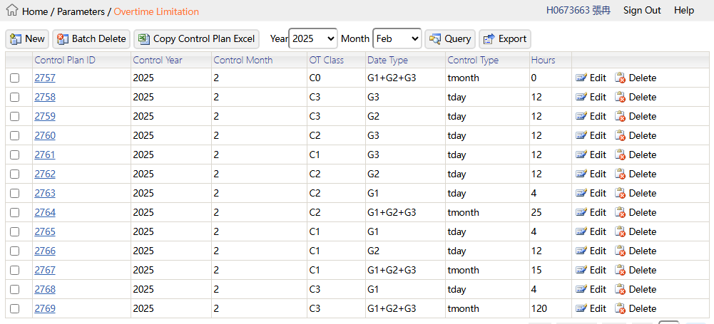
Overtime Limitation Definition
HR can define the different OT categories limitation OT hours for different overtime types in each month.

Slide 51
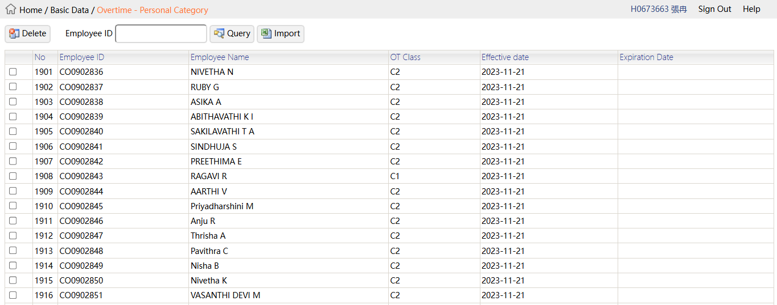
Employee Overtime Class -1
Arrange employee’s OT limitation.
HR can define the different OT classes limitation OT hours for different overtime types in each month.

Slide 52
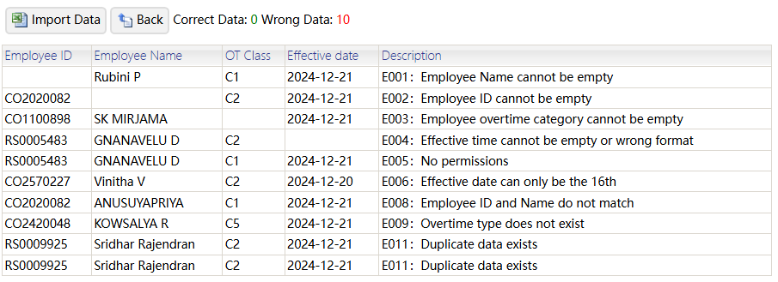
Employee Overtime Class - 2
An example of check results:
Detailed explanation of check rules:
E005: User does not have department or site permissions.
E006: Effective Date must be 21th

Slide 53
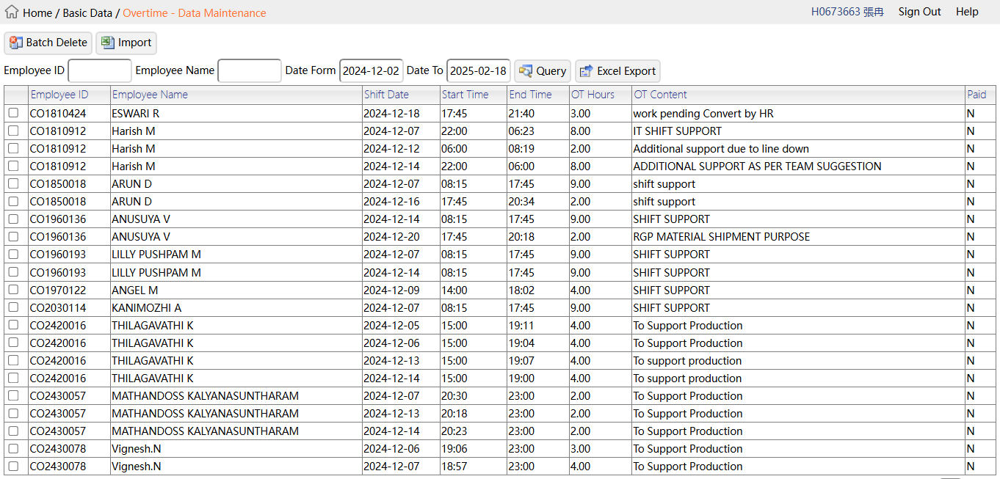
Overtime Data Maintenance

Slide 54
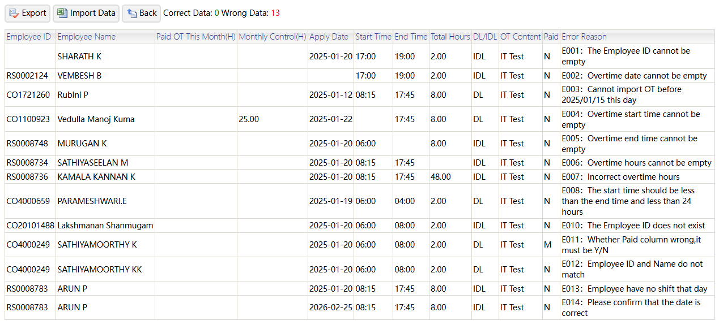
Overtime Data Import Check - 1
An example of check results:

Slide 55
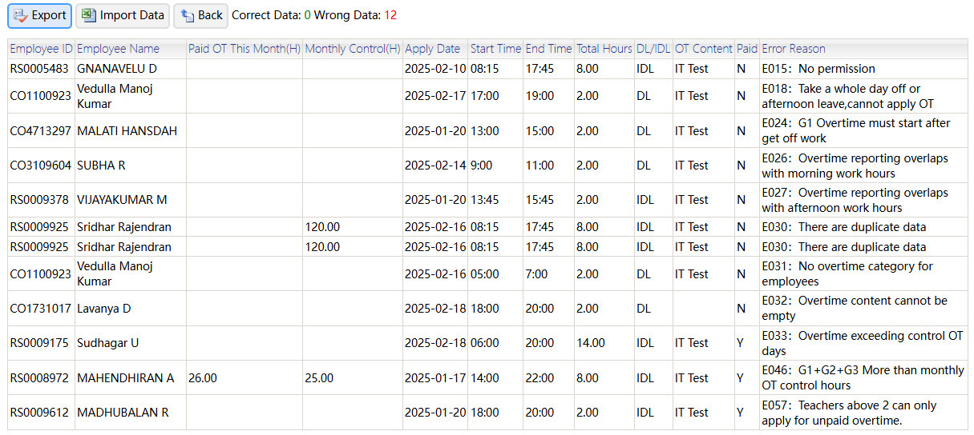
Overtime Data Import Check - 2
An example of check results:

Slide 56
Overtime Data Import Check - 3
Rules:
E007: The number of overtime hours cannot be greater than the difference between the start time, end time, and meal time.
E011: Is Paid this field must be entered, Y or N, no other value can be entered
E013: To apply for overtime, employees must have corresponding shifts on the day they work overtime.
E015: User does not have department or site permissions.
E018: When employees take leave for a full shift or second shift, they cannot apply for overtime on that day
E026/E027: Overtime hours cannot conflict with working hours
E033-E046: Overtime hours exceeding control OT days/week/month/year
E048: The OT application already applied on that day, and if you import data, it will overwrite the original data
E056: There is no schedule data for the next day for employees working night shifts. Please check and import the schedule data for the next day.

Slide 57
Overtime Approval Process
Approval Process
How to split and merge processes?
Batch Import Data
Split by sections for section manager to do approval
Section 1
Section 2
Section 3
Section 4
Section 5
Merge to one process for department head to do approval.
Department 1
Department 2
Go ahead to division head directly.
Go ahead to division head directly.
Division Approver A
Division Approver B

Slide 58
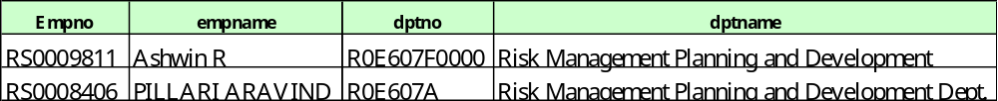
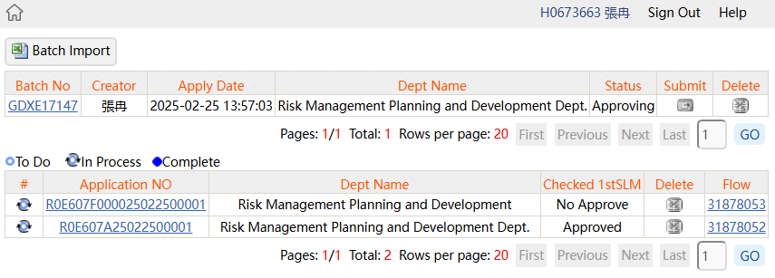
Overtime Approval Process
Detailed explanation of batch apply overtime:
Example: Apply for 2 employees at different levels under the same department
Divide by department and merge into one process for approval by department heads.
Click here to import Overtime
Batch No | Apply No | PID
GDXE17147 | R0E607F000025022500001 | 31878053
 | R0E607A25022500001 | 31878052

Slide 59
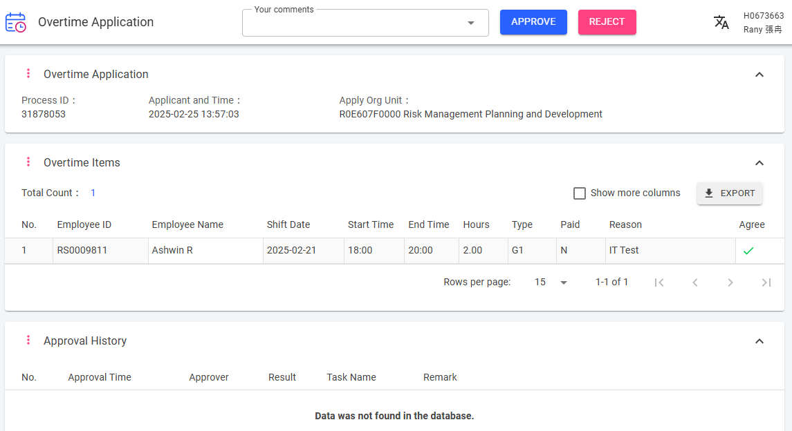
Overtime Approval Supervisor review
Supervisor review : login workflow account for approval
s
Comments
Overtime Items
Approval History

Slide 60
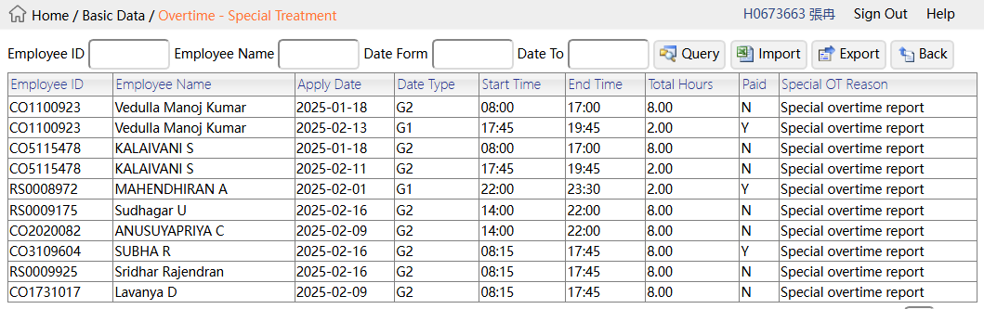
Overtime - Special Treatment
Special overtime is used when there is no punch-in information.
Tips: This function should not be used for normal overtime data processing.

Slide 61
Reports
Daily Report
Period Report
Monthly Report
Monthly Paydays Report

Slide 62


Report Overview
Daily Report
Period Report
Monthly Report
Monthly Paydays Report
Absentee Detail List
Absentee Detail List
OT Detail List
RL Paydays Report
Card Record Data
Clock Record Data
OT Statistics
CL Paydays Report
OT Detail List
Vacation OT Report
Attendance Record
Site Attendance
Department Card Location
Card Record Weekends
Department Shift Type
Department Clock Record
Clock-out more than 30
Card Record Leave Day
Department Attendance detail
Unfinished process report
A variety of reports can meet the needs of exporting data with different control permissions and requirements.
We will take the daily report as an example to explain it briefly.

Slide 63
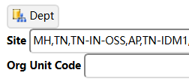
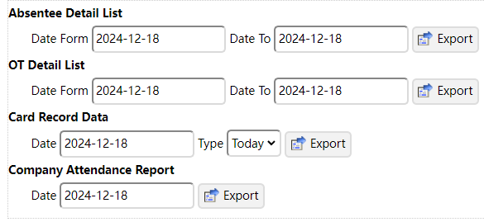
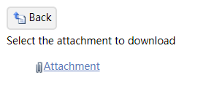
Report Filters
All Report export use the same method, which will not be discussed in detail later.
1
Click the “Dept” button or You can also input Dept Code in “Org Unit Code”
3
Choose the date range, and click the “Export”
4
Click the “Attachment” to download the excel.

Slide 64

Daily Report
Absentee Detail List
Card Record Data
OT Detail List
Overtime Items
Company Attendance
A variety of reports can meet the needs of exporting data with different control permissions and requirements.
We will take the daily report as an example to explain it briefly.

Slide 65
Other Reports
Report > Period Report > OT Report
examples about OT report
Report > Monthly Report> OT Detail List
Report > Monthly Report> OT Statistics
There are various other reports, come and try them yourself
Report > Batch Employee Report >Daily Report> OT Detail List
Report > Batch Employee Report >Time Period Report> Absentee Detail List

Slide 66
Workflow
Mail notification and approval
Approvers customized
Batch Approval & Mobile Approval
Approval Process Tracking

Slide 67
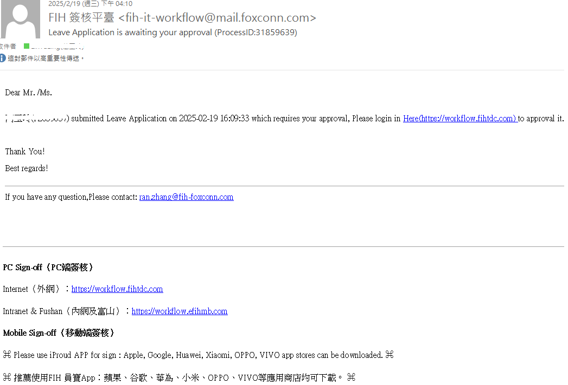
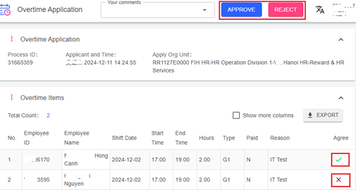
Mail notification and approval
1
2
3
You will receive an approval email
if you need to approval
Login in https://workflow.fihtdc.com
On the “FIH Tasks To Do” page,
Click the “Task” link
Approval the Application form
Click the “APPROVE” or “REJECT” to agree or reject this application,You can single reject somebody’s application by “Agree” set.

Slide 68
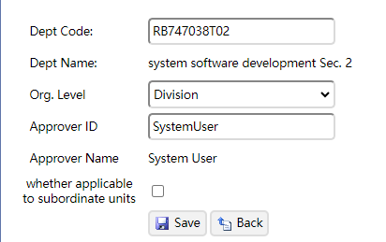
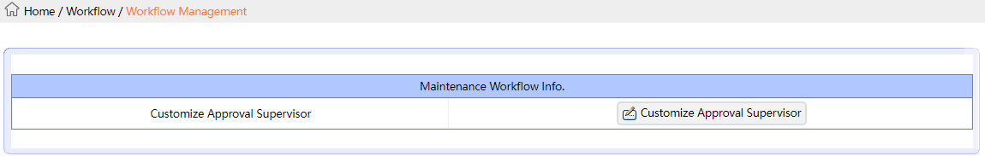
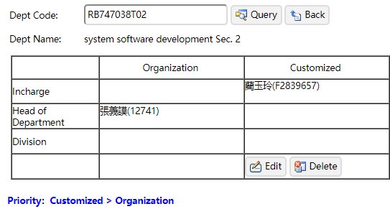
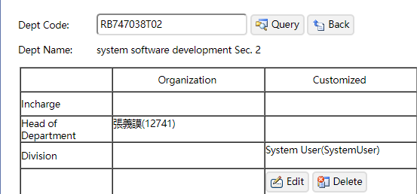
Approvers Customize - 1
The source of the supervisor comes from two parts:
Main : Organization System
Priority : TA Customized>Organization System
Select Org. Level, Input Approver ID,Click “Save”
3
1
Input Dept Code , Click “Query” to show
Set success,
It adjusts to all TA form applications later on
2
4
Click “Edit” to Customize,Click “Delete” to delete all customized supervisors of this department code.

Slide 69



Approvers Customize - 2
1
2
3
If you want to skip the approver,input “SystemUser” in Approver ID.
Click the “Check” option and click “Save”.this set will apply to all subordinate units
4

Slide 70




Batch Approval & Mobile Approval
You can Batch Approval by Click “Batch Submit” in Workflow Portal Web Site
You can also online approval in Mobile App
1
2
3

Slide 71

Approval Process Tracking
Application
Progress Tracking
1
2
3
4
1
Status Icon displays the current status of the application
2
Click “Submit” to sent the application to approval
You can only click “Delete” to delete the application Before submit.
3
4
Click “Flow” to view the Flow Chart

Slide 72
Personal Service
Employee personal inquiry on PC
Personal inquiry on mobile (Mobile App)
Leave application on mobile (Mobile App)

Slide 73


Personal Service on PC- 1
Abnormal Record: The type, reason and hours of the employee’s absence.
There are roughly 7 categories of absence types: Absent, LateToWork, OffWorkEarly, Leave, Trip and Support.
Clock Record: Employee entry and exit clock records.

Slide 74


Personal Service on PC- 2
Period Overtime : Details of overtime results after analysis.
1. Valid Overtime is generated based on overtime application, clock Record, etc.
2. Consistency is the analysis’s result.
Monthly Overtime: Monthly statistics on effective overtime hours, compensated rest hours and remaining hours.
1. 'Effective OT Hours’ is the effective overtime statistics for this month.
2. 'Off this month(H)' and 'Hours Remaining' are the used hours and remaining hours of 'Lieu leave from OT'.
3. Effective overtime hours per day this month.

Slide 75

Personal Service on PC- 3
Integrated Query: One day's punch-in/out, shift schedule, absence details, working hours, etc.

Slide 76





Personal Service on PC- 4
Calendar View: One month’s shift schedule, leave type, working hours, etc.
Monthly effective working hours statistics
Shift
Leave
Comp
off
Paid
OT

Slide 77






Personal Service on Mobile App
Monthly statistics
1
Choose “India Attendance”.
2
Enter calendar view.
3
Click on the module or date.
2
Details of each day

Slide 78



Leave application on Mobile App
Leave application on iProud app only for IDL employees.
1
Choose Select module Leave
3
Fill in leave info
5
Submit verified leave request
2
Click the button
4
Verify saved leave info and show error message

Slide 79
IT Support
Wade Xiao
560-23311
wade.ws.xiao@fih-foxconn.com
Ran Zhang
566-76786
ran.zhang@fih-foxconn.com

